Slide 1
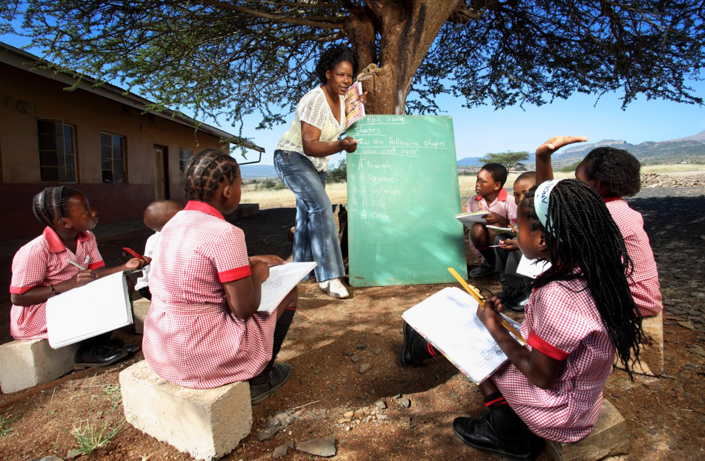
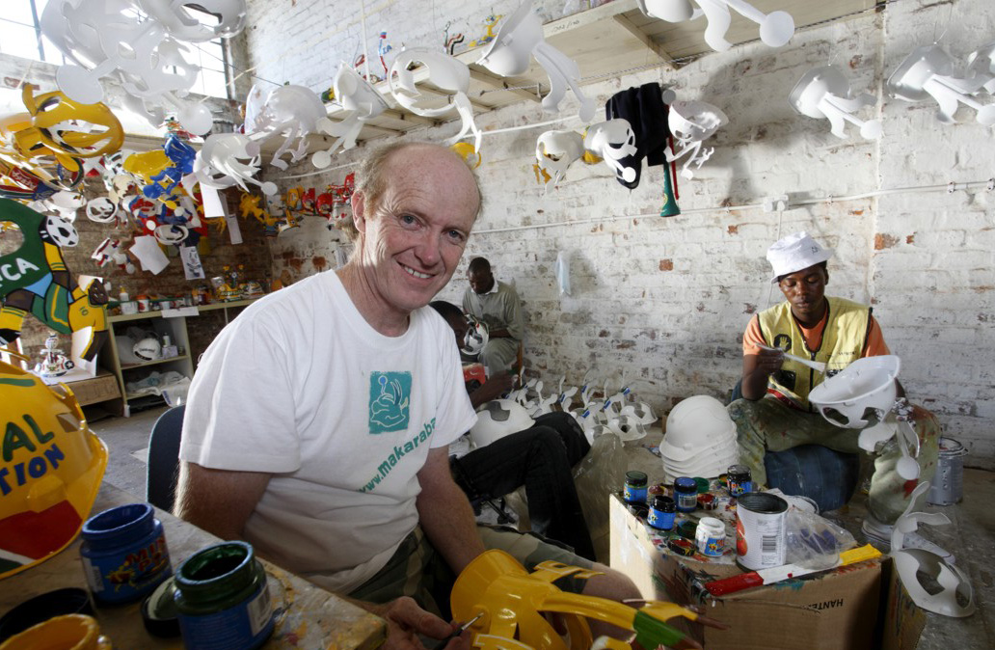
Measuring volunteer work in South Africa
Malerato Mosiane
Statistics SA
#StatsSA

Slide 2
Background
The SA QLFS does not capture volunteer work.
A special survey (Volunteer Activities Survey (VAS)) is designed to collect such information.
Objectives of VAS are to:
collect data about people who are involved in volunteer activities.
identify organisation-based and direct volunteering.
give a profile of those engaged in volunteer activities.
estimate the economic value of volunteer work.

Slide 3
Background…
VAS is a household-based survey that collects data on the volunteer activities of individuals aged 15 years or older.
A sub-sample of QLFS – two-phase survey
1st phase - Volunteers identified through QLFS
Individuals are asked whether they were involved in any volunteer activities in the 4 weeks prior to the interview.
2nd phase - individuals eligible for VAS are then followed up to conduct detailed interviews about their volunteer activities during the reference period.

Slide 4
Background…
Individuals are asked to indicate all volunteer activities they were involved in the four weeks prior the interview.
Details are collected for the 3 main activities only in the past four weeks.
Main volunteer activity is regarded as the one on which the respondent spent the most time.
Volunteer activities for the past 12 months also collected
Conducted in 2010, 2014 and 2018 (PAPI)
Next survey in 2022 (CAPI/CATI/CAWI)

Slide 5
Challenges with data collection
Data is collected by the QLFS fieldworkers, so they may not indicate all the volunteers to reduce work for themselves – it would have been ideal to have a separate team collecting data on volunteer work
A lot of probing has to be done because most people don’t regard the activities that they do for others as volunteering
Volunteering may be under-estimated as a result of the above

Slide 6
Why measure volunteer work regularly?
Forms of work and the SNA 2008
Data collected through these survey to provide a comprehensive picture of all forms of work undertaken in the SA economy

Slide 7
Definition
“Unpaid non-compulsory work done for others; i.e. time individuals give without pay to activities performed either through an organization or directly for others outside their own household.”

Slide 8
Data items collected
Type of activities volunteers engage in
Number of hours volunteered
Type of work performed (Occupation)
Institutional setting of volunteer work
Organisation-based (NGO, Government, etc)
Direct
Field of work (Industry)

Slide 9
Key indicators
Number of volunteers
Volunteer rate
Hours volunteered
Value of volunteering

Slide 10
Valuing volunteer work
One of the objectives of the survey is to estimate the economic value of volunteer work
There are two general approaches available to measure the monetary value of volunteer and other unpaid work:
Opportunity cost method
Replacement cost method

Slide 11
Opportunity cost method
This method estimates the value by assigning to the hours of volunteer work the average wage that the volunteer would earn if that volunteer worked at his or her regular job for those same hours.
E.g. - a medical doctor volunteering as a teacher assisting in basic adult education programme in his community - his work will be valued at the rate he or she gets as a Doctor not as a teacher.

Slide 12
Replacement cost method
This method estimates the value by assigning to hours of volunteer work what it would have cost to hire someone for pay to do the work that the volunteer is doing for no pay.
E.g. - a medical Doctor volunteering as a teacher - his work will be valued at the rate of what a teacher gets paid.
This is the method recommended by ILO and it is adopted in South Africa

Slide 13
Computing value of volunteer work
Median hourly earnings by occupation (from QLFS) was used to assign value to the hours a volunteer worked in a particular occupation.
The median hourly earnings were multiplied by the total hours volunteered to get the value for the reference period (four weeks prior the interview)
This value is converted to an annual value for the 12 month reference period.

Slide 14
Some indicators, 2018
Indicator | Men | Women
Number of volunteers | 1,0 Million | 1,7 Million
Volunteer rate | 5,1% | 8,1%
Hours volunteered | 243,8 Million | 395,9 Million
Value of volunteering (ZAR) | R5,9 Billion | R7,3 Billion
Source: Statistics South Africa, Volunteer Activities Survey, 2018
Of the 2,7 million volunteers, 61,9% were women

Slide 15
Dissemination
Media briefings
Reports published on the website
http://www.statssa.gov.za/publications/P02113/P021132014.pdf
Micro data and metadata available on the website free of charge
http://nesstar.statssa.gov.za:8282/webview/

Slide 16
Future innovations
A need to have a central database where volunteers can register
Collect basic information from them as the register – sign on questionnaire
Indicate the activities that are available for people to volunteer in
Have a portal where volunteers can capture the activities they were involved in and time they spent volunteering on a daily basis
Have a volunteer work barometer – to monitor some key indicators based on the data on the database
This is possible for Organisation based volunteering

Slide 17
Thank you!

